Slide 1

HIGH PERFORMANCE SRAM DESIGN FOR ENERGY EFFICIENT SYSTEMS
NARALASETTI UMESH SURYA KIRAN - 42130311 (A5)
VADDI UGANDHAR - 42130516 (B3)
Guided by:
Dr. T. RAVI, M.E., Ph.D.
Professor & Head
Dept. of Electronics and Communication Engineering
Sathyabama Institute of Science and Technology, Chennai

Slide 2
OVERVIEW (Presentation)
Introduction
Workflow
Literature Survey
Problem Definition
Objectives
Existing System
Proposed System
Circuits and Simulation
References

Slide 3
INTRODUCTION
SRAM plays a critical role in low-power VLSI systems, especially for IoT and portable devices.
Operating at ultra-low voltage is essential for energy-efficient design.
Conventional SRAM (6T, 8T) suffers from read stability issues, leakage, and high power in sub-threshold region.
Focuses on analyzing 6T and 7T SRAM architectures and proposing a replica-assisted adaptive wordline controlled 6T SRAM macro for improved stability under voltage scaling.

Slide 4
STANDARDS
SDG
SDG – 9 : Industry, Innovation and Infrastructure
SDG – 12 : Responsible Consumption and production
IEEE 1801 – UNIFIED POWER FORMAT
IEEE 1685 – IP XACT (INTEGRATED FOR MEMEORY BLOCKS IN SoC’S)
IEEE 2416 – LOW POWER WORKING GROUPS

Slide 5
WORKFLOW
Literature review on low-power SRAM and replica-based timing
Design and simulate 6T SRAM in Cadence Virtuoso
Design and simulate 7T SRAM in Cadence Virtuoso
Compare results: SNM, power, delay, transient stability
Identify drawbacks of 7T (area/power/delay overhead)
Propose Replica-assisted Adaptive WL Control for 6T SRAM macro
Implement 16×8 SRAM macro + 1 replica column
Validate improvements through simulation and comparison

Slide 6
Literature Survey
S.No | Title & Year | Author(s) | Contribution | Inference
1 | A Low-Power Variation-Tolerant 7T SRAM With Enhanced Read Sensing Margin for Voltage Scaling (2024) | R. S. Shreedhar et al. | Proposed 7T SRAM for voltage scaling | Improved SNM but slow read speed
2 | A PMOS read-port 8T SRAM cell with optimized leakage power and enhanced performance (2023) | M. I. Shakil et al. | PMOS read port for leakage reduction | Needs precharge, larger area
3 | SRAM read and write assist apparatus (2023) | US Patent US8630132B2 | Assist circuits for read/write stability | Adds complexity and power

Slide 7
Literature Survey
S.No | Title & Year | Author(s) | Contribution | Inference
4 | A replica technique for word line and sense control (2023) | R. Rajsuman | Replica column for timing optimization | Improves reliability but increases complexity
5 | Design and Analysis of Fast Low Power SRAMs (2023) | B. Amrutur, M. Horowitz | Optimized low-power SRAM design | Needs complex control circuits
6 | Multi-stage dual replica bit-line delay technique (2023) | Z. Liu et al. | Timing for low-voltage sensing | Area overhead, complexity

Slide 8
Literature Survey
S.No | Title & Year | Author(s) | Contribution | Inference
7 | A Reconfigurable Replica Bitline to Determine Optimum SRAM Sense Amplifier Set Time (2022) | P. Panigrahi et al. | Adaptive sensing for timing optimization | Accurate but adds hardware complexity
8 | On the Efficacy of Write-Assist Techniques in Low Voltage Nanoscale SRAMs (2021) | K. Takeda et al. | Evaluates write-assist techniques | Improves write margin but power penalty
9 | Low Voltage and Low Power in SRAM Read and Write Assist Techniques (2021) | M. Kumar et al. | Comparison of assist schemes | Adds energy and design complexity

Slide 9
PROBLEM DEFINITION
To design a low-power SRAM macro that improves read stability and write reliability under voltage scaling while maintaining the area efficiency of conventional 6T SRAM.

Slide 10
OBJECTIVES
To design and simulate 6T SRAM and 7T SRAM cells in Cadence Virtuoso (90nm).
To evaluate performance metrics: SNM, delay, power, energy.
To identify drawbacks of 7T SRAM in terms of area and power overhead.
To propose a replica-assisted adaptive wordline-controlled 6T SRAM macro.
To implement a 16×8 SRAM macro with a replica column and validate reliability improvements.

Slide 11
EXISTING SYSTEM
Conventional 6T SRAM
  Area-efficient
  Suffers from read disturb and low SNM at low VDD
Conventional 7T SRAM
  Improves read stability by decoupled read path
  But increases power, delay, and area

Slide 12
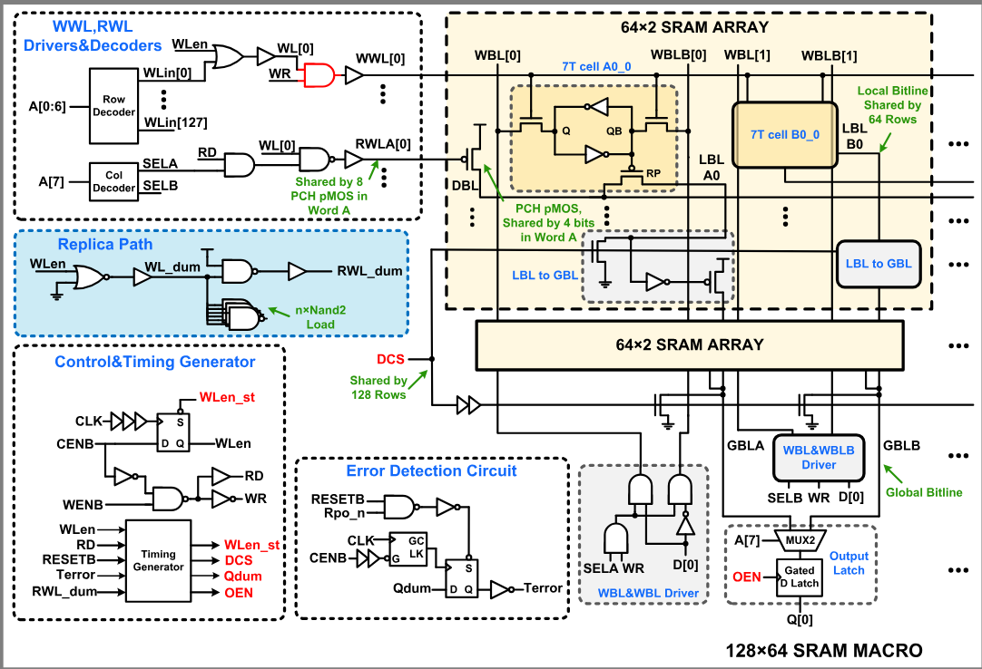
EXISTING SYSTEM

Slide 13
PROPOSED SYSTEM
Replica-assisted adaptive wordline control in standard 6T SRAM macro
  Uses standard 6T bit-cell (no modification)
  Adds 1 replica column (16×1)
  Replica bitline discharge used to generate adaptive WL pulse
  Improves:
    read stability
    write success probability
    reduces unnecessary WL ON time
  Lower overhead compared to 7T cell-based macro

Slide 14
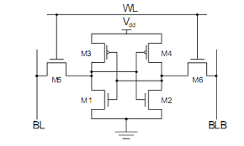
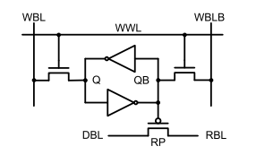
6T & 7T SRAM SECHMATIC
6T SRAM SECHMATIC
7T SRAM SECHMATIC

Slide 15
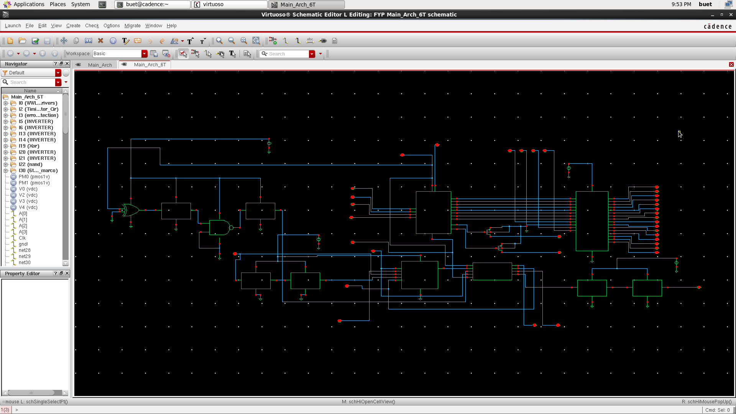
CIRCUIT DIAGRAMS
6T Architecture

Slide 16
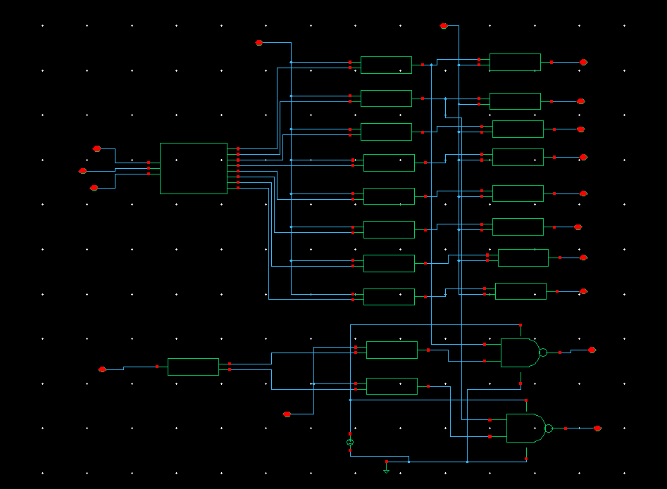
CIRCUIT DIAGRAMS
WWL, RWL Driver Circuit

Slide 17
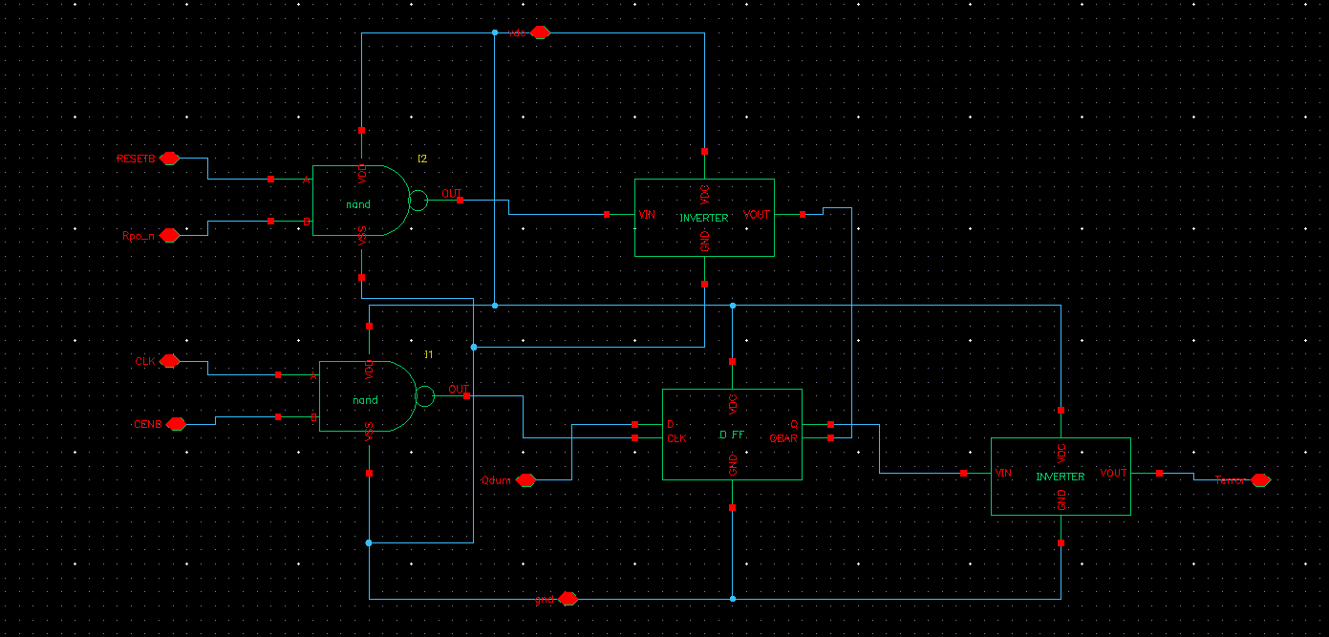
Control & Timing Generator Circuit

Slide 18
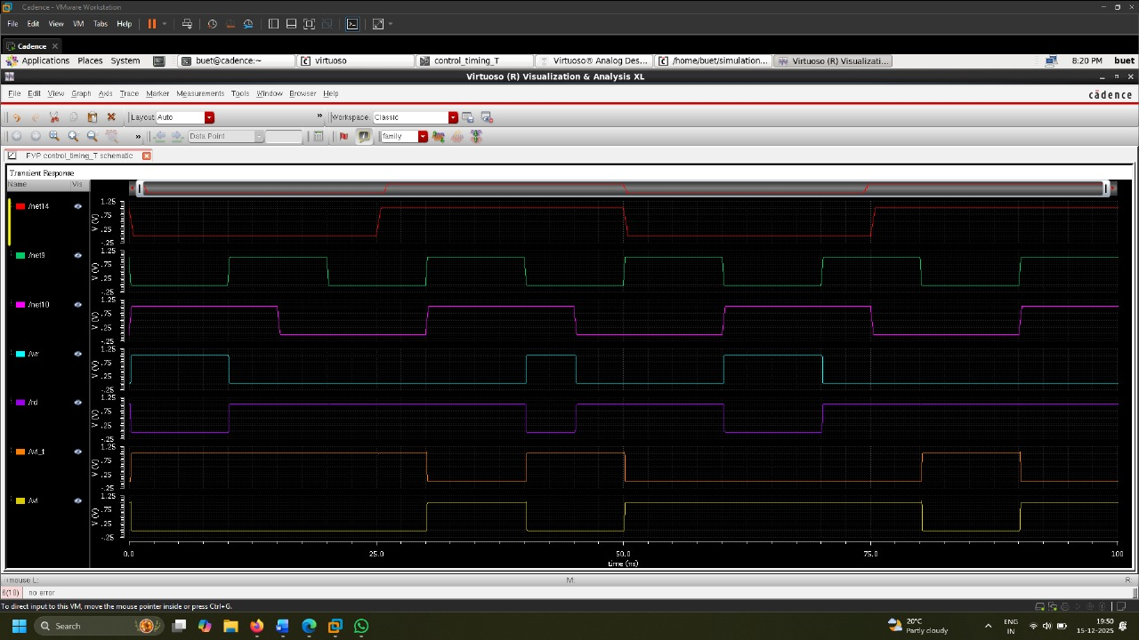
Control & Timing Generator Circuit output waveform

Slide 19
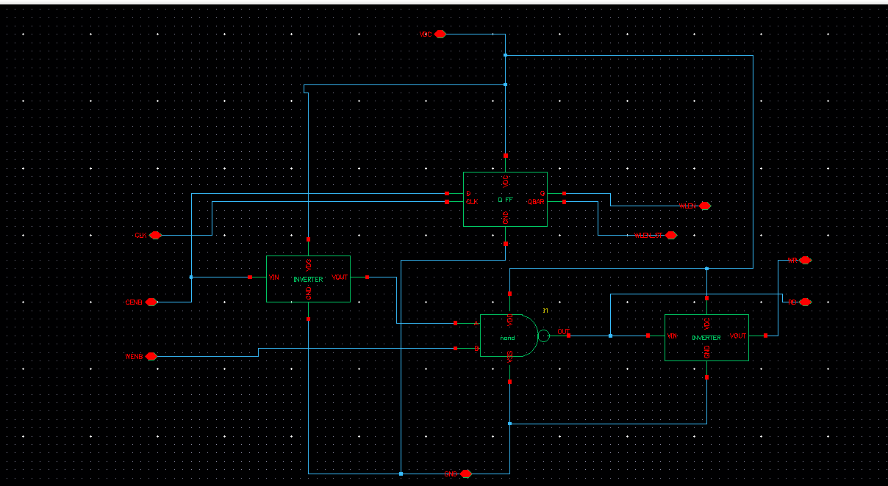
Error Detection Circuit

Slide 20
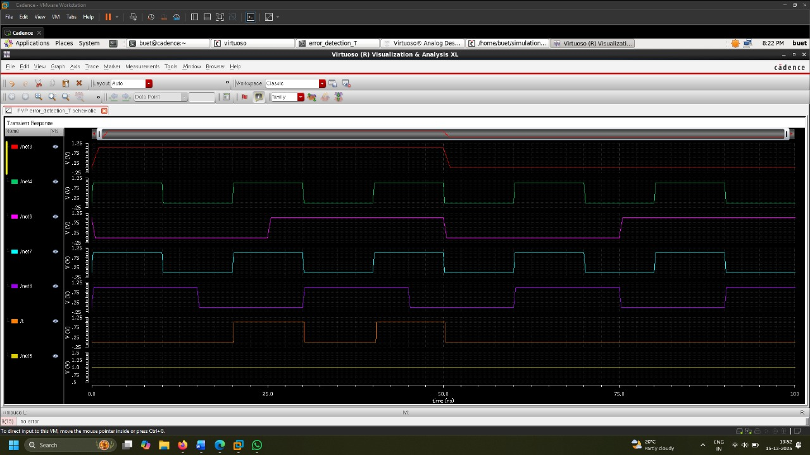
Error Detection output waveform

Slide 21
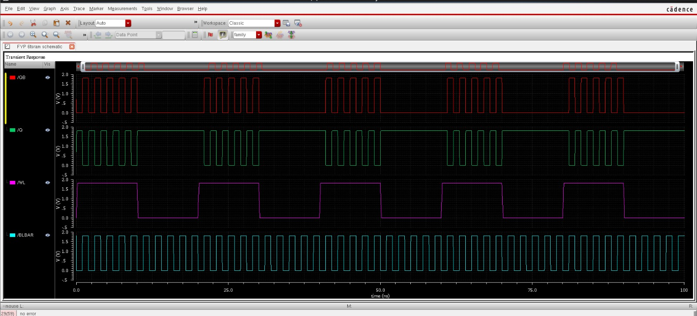
6T & 7T SRAM Design and analysis

Slide 22
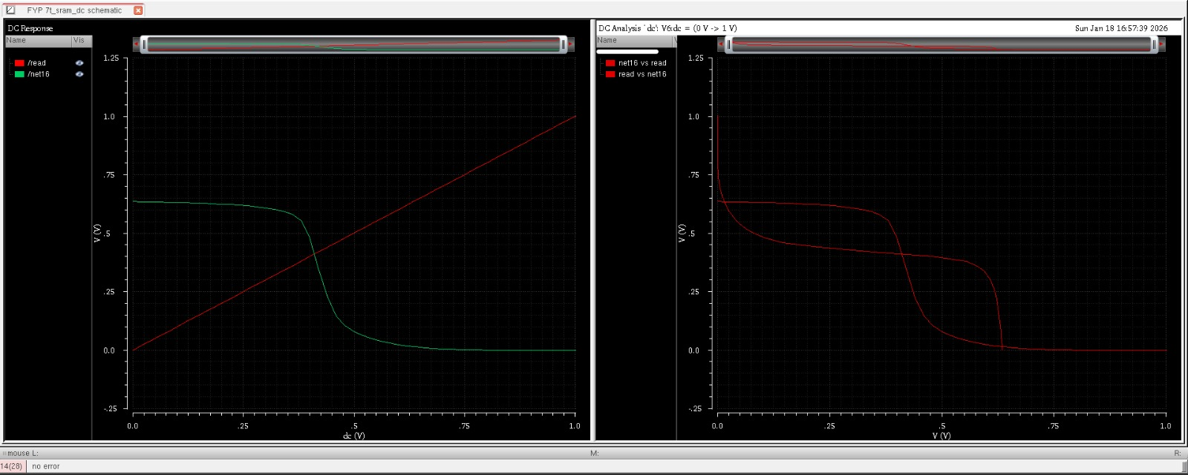
6T & 7T SRAM Design and analysis

Slide 23
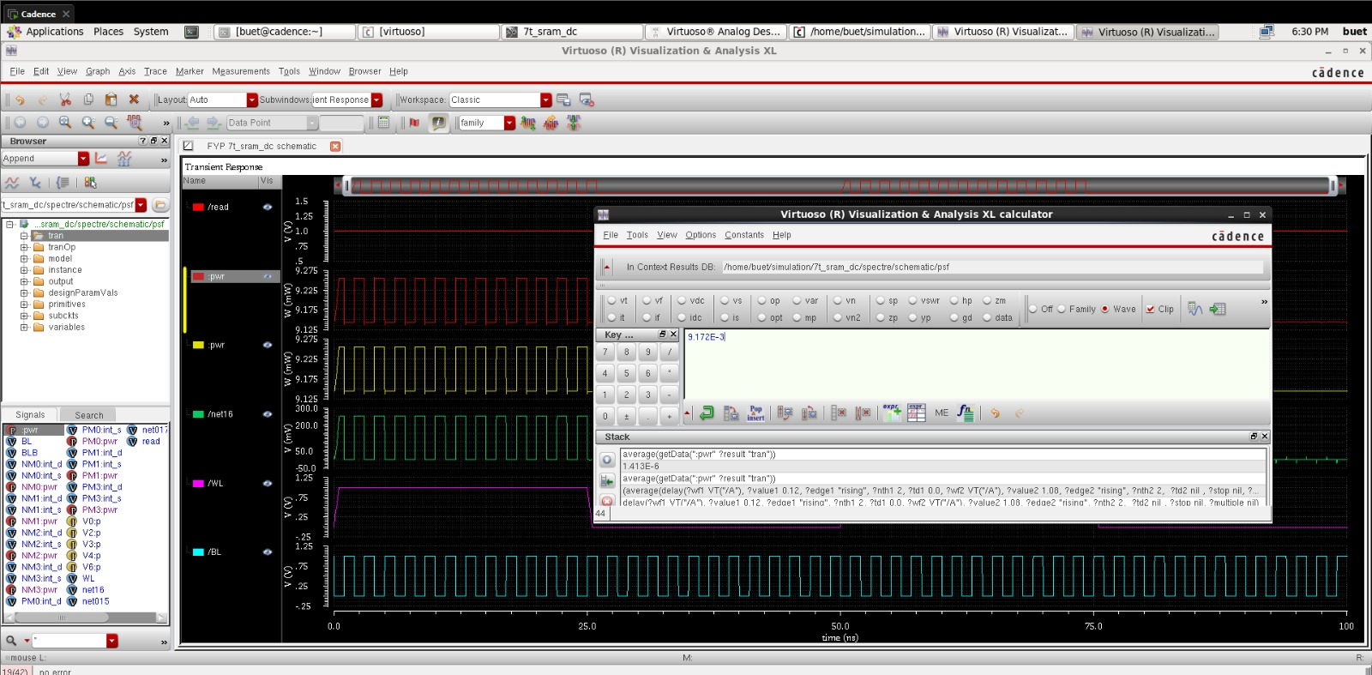
6T & 7T SRAM Design and analysis

Slide 24
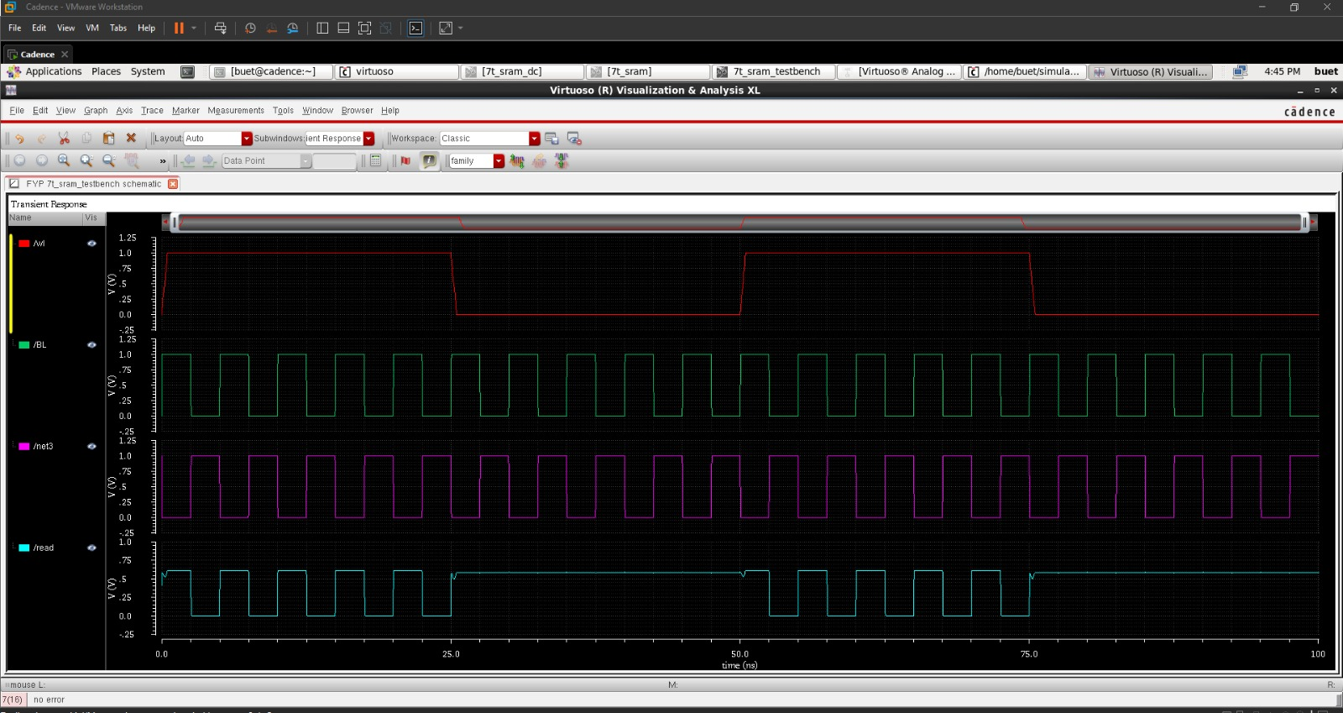
6T & 7T SRAM Design and analysis

Slide 25
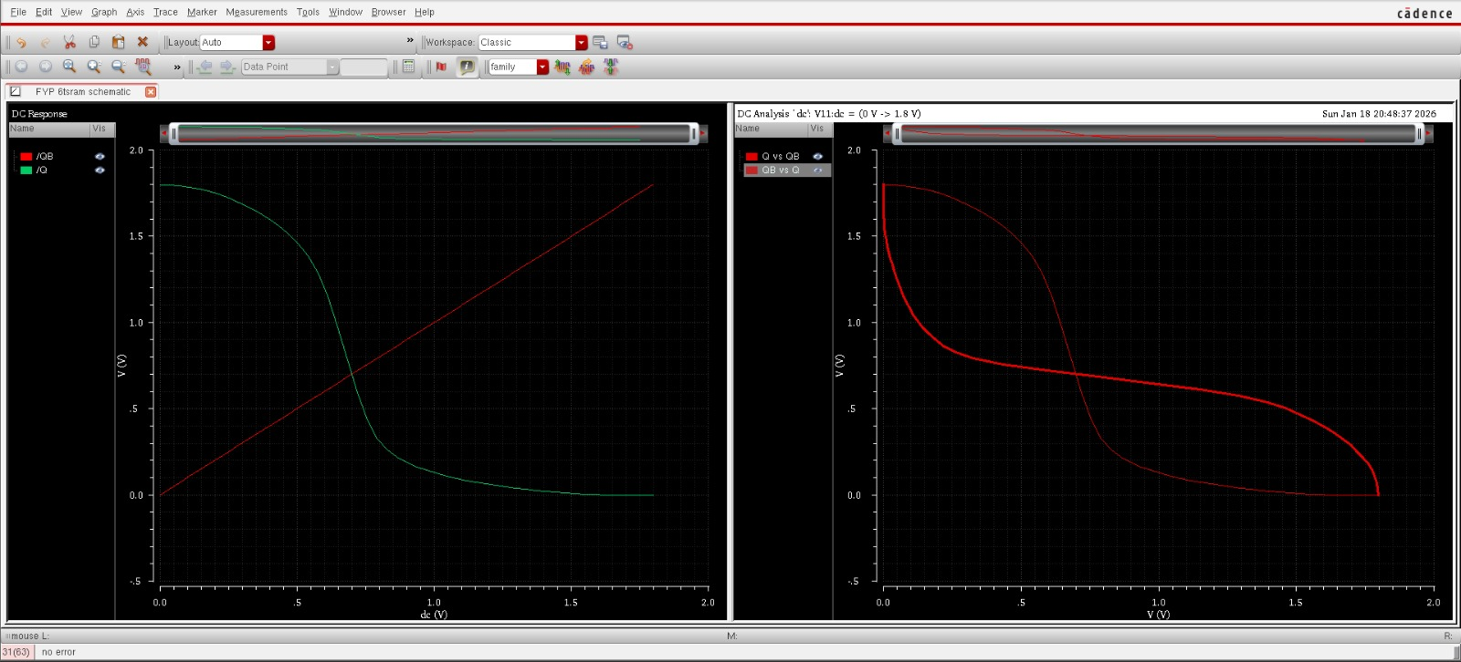
6T & 7T SRAM Design and analysis

Slide 26
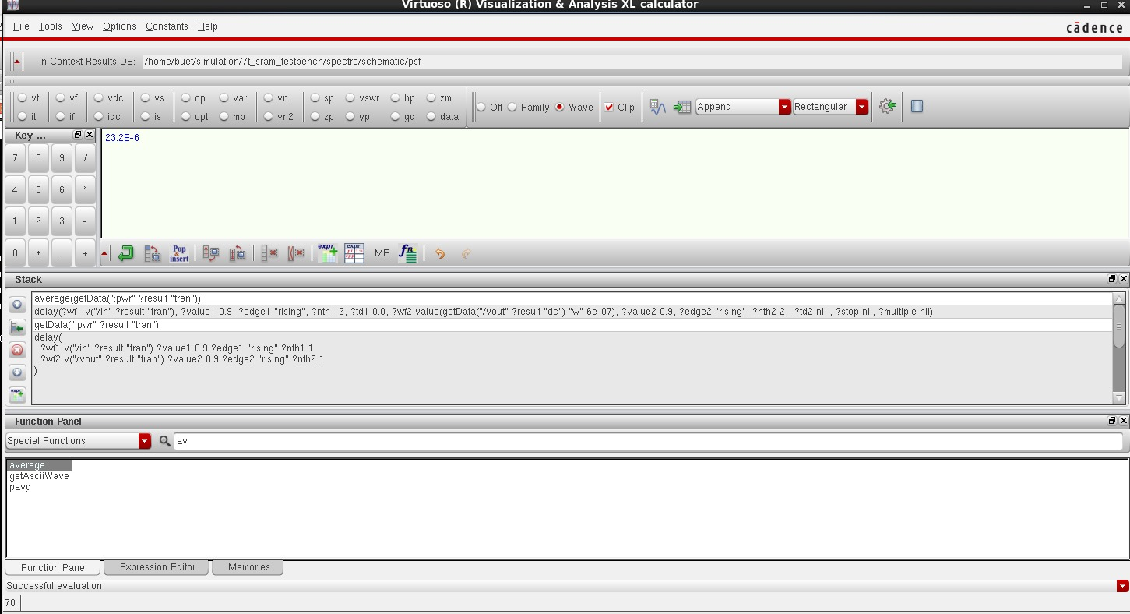
6T & 7T SRAM Design and analysis

Slide 27
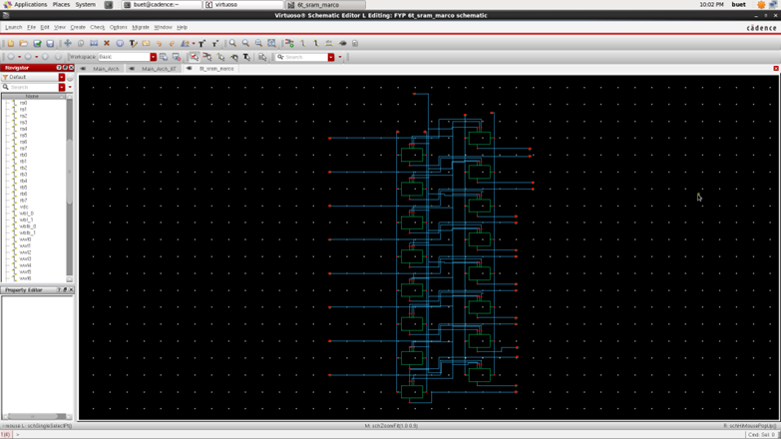
6T Macro

Slide 28
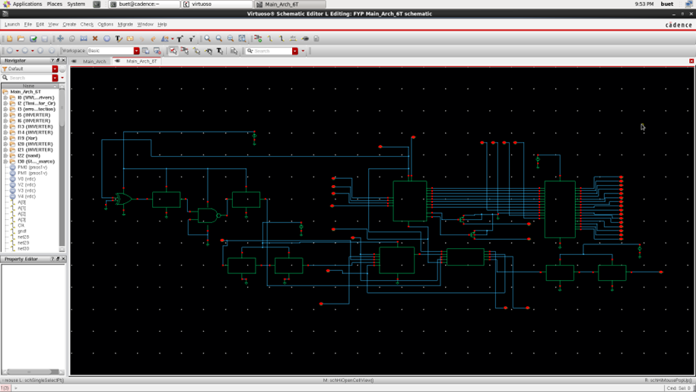
6T macro with architecture

Slide 29
COMPARISON
Metric | 6T SRAM | 7T SRAM
Static Noise Margin (SNM) | 0.31 V | 0.47 V
Read Delay | 1.18 ns | 1.63 ns
Write Delay | 0.92 ns | 1.34 ns
Average Power | 9.17 µW | 11.41 µW
Read Energy | 10.82 fJ | 18.59 fJ
Total average power | 1.98E-6 | 4.68E-9

Slide 30
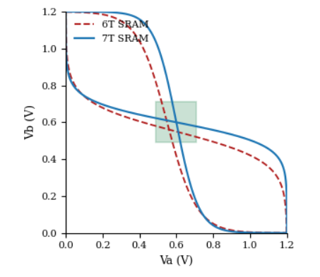
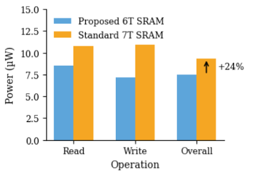
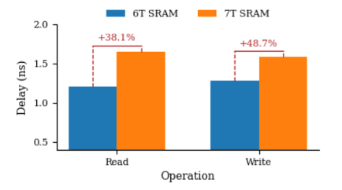
RESULT
Static Noise Margin (SNM) comparison using butterfly curves
Average power consumption comparison of 6T and 7T Architecture
Read and write delay comparison of 6T and 7T Architecture

Slide 31
REFERENCES
[1] A Low-Power Variation-Tolerant 7T SRAM With Enhanced Read Sensing Margin for Voltage Scaling.
[2] A PMOS read-port 8T SRAM cell with optimized leakage power and enhanced performance.
[3] US8630132B2 - SRAM read and write assist apparatus - Google Patents.
[4] A replica technique for wordline and sense control in low-power SRAM's.
[5] DESIGN AND ANALYSIS OF FAST LOW POWER SRAMs - Stanford VLSI research group.
[6] Multi-stage dual replica bit-line delay technique for process-variation-robust timing of low voltage SRAM sense amplifier.
[7] A Reconfigurable Replica Bitline to Determine Optimum SRAM Sense Amplifier Set Time.
[8] On the Efficacy of Write-Assist Techniques in Low Voltage Nanoscale SRAMs.
[9] Low Voltage and Low Power in SRAM Read and Write Assist Techniques - IJSTE.

Slide 32
THANK YOU

